Slide 1
Visual Cryptography for Biometric Privacy
Suprabha Student
Shravan Kumar Student
M B Sachin Student
Sooraj Shetty Student

Slide 2
Abstract
Introduction
Literature Survey
Problem Definition
Contents
Proposed Work
Methodology & Implementation
Results & Discussions
Conclusion
References

Slide 3
Abstract
Cryptography secures the data during the interaction between different systems. “Biometric”, is used for authentication. The attackers may use the opportunities to attack the data within the database.
Therefore, the security of biometrics is of high importance.
In this idea, a private image is bifurcated into two shares of images and these images to be displayed when the two share images are available together; photos of sole share cannot reveal the identity of the actual image.
To achieve this, Visual Cryptography is used.
This process encrypts a private image into stocks so that it can collect a sufficient number of shares produces a private image.
This project uses VC of colored images in a biometric application.

Slide 4
Introduction
In today’s fast developing era, security plays a very important role in the daily life.
Today, more and more digital documents are transmitted and exchanged on internet. Security has become the important features in communication and other text information, this is because of the presence of hackers who wait for a chance to gain an access to private data.
A biometric authentication system operates by acquiring raw biometric data from a subject, extracting a feature set from the data and comparing the feature set against the templates stored in a database in order to identify a person or to verify a claimed identity.
Many biometric techniques are available such as fingerprint, face, iris, retina, palm print, hand vein, facial thermogram, keystroke, voice, hand geometry and signature etc.
The template data in the database is generated during enrolment and is often stored along with the original raw data.

Slide 5
Literature Survey
[1]. Arun Ross, Asem Othman, “Visual Cryptography for Biometric Privacy”, IEEE Transactions On Information Forensics And Security, VOL.6 No.1, MARCH 2011. In the proposed scheme, an image is bifurcated into two shares to be displayed only when these two shares are available together; photos of individual hosts won’t reflect the identity of the original image.
[2] Naor, M. and Shamir. A, “Visual Cryptography” EUROCRYPT 1994. Lecture Notes in Computer Science, Vol. 950. Springer, Berlin, Heidelberg (1999). foundation for VC was laid. It assumes that the message is a combination of two elements i.e., white and black pixel. It has a problem of pixel-expansion, i.e., the size of the original message is not the same as the received message.
[3]. Atul Sureshpant Akotkar, Chaitali Choudhary, “Secure of Face Authentication using Visual Cryptography”, International Journal of Innovative Science and Modern Engineering (IJISME) ISSN: 2319-6386, Volume-2, Issue-5, April 2014. In this paper, during encryption part actual image is decompose in to three shares this can be done for a greater number of share generation in future so that security will enhance. This paper implements VC for color images in a biometric application.

Slide 6
Contd.
[4]. P. Punithavathi & S. Geetha (2017), “Visual cryptography: A brief survey”, Information Security Journal: A Global Perspective, 26:6, 305-317. In this paper, various visual cryptography techniques have been discussed. The metrics used to analyse the effectiveness of visual cryptography techniques have been briefed. The significant applications of visual cryptography have also been summarized in the survey. The term “visual” in visual cryptography stands for the fact that during decryption phase, a user can perceive the recovered secret with his/her visual system, without the intervention of machines.
[5] M. Karolin and T. Meyyappan, “Secret Multiple Share Creation with Color Images using Visual Cryptography”, April 4-6, 2019, India, IEEE. Various aspects of VC are discussed. Criteria used to evaluate the efficiency of visual coding systems are explained. Significant use of VC has also been summarized in the study. In this case it suggests that during the encryption phase, the user can see the secret obtained through their detection system, without the intervention of equipment.
[6] M. Karolin, T. Meyyappan, “Image Encryption and Decryption using RSA Algorithm with Share Creation Techniques”, ISSN: 2249 – 8958, Volume-9 Issue-2, December 2019. This paper suggests an algorithm i.e., the Floyd Steinberg dithering algorithm which is used to manipulate the code of 256-bit image to low code image and for information sharing RGB image is used. In place of the dithering algorithm, we use half toning process.

Slide 7
Problem Definition
When we transmit data over the network, then any unauthenticated person can read our data. So, in order to provide the security to data generally the sender will encrypt the data and then send it to the intended person and the receiver will decrypt that encrypted data and uses it.
Visual Cryptography comes with the guarantee of the security by means of defining perfect secrecy. Usually, a set of attackers are not allowed to learn any information about the secret image even under the possibility of collusion.

Slide 8
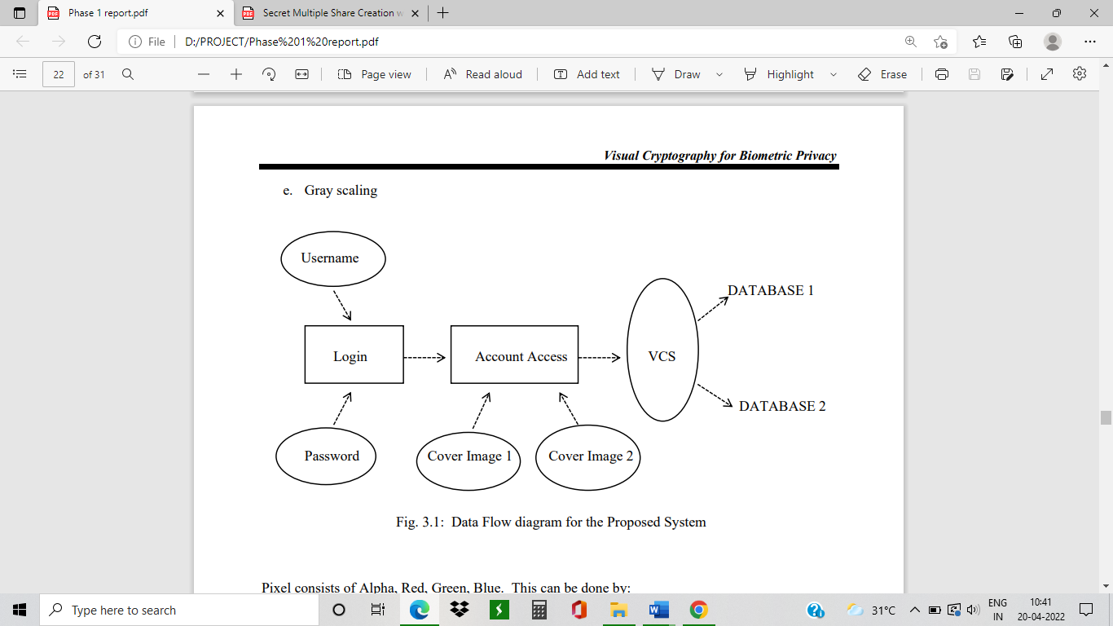
Proposed Work
The two stages of biometric system are registration and recognition.
The first step involves extracting the feature and pre-processing. The features are stored as templates on the database.
This proposed method is divided into 3 parts, namely Image Encryption, Image Decryption and Face Matching.

Slide 9
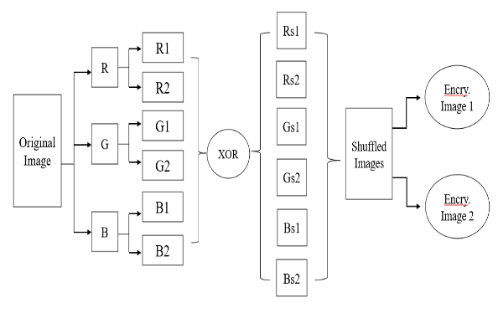
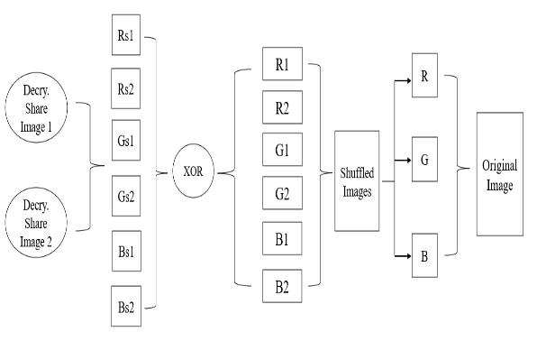
Methodology & Implementation
Encryption
Decryption

Slide 10

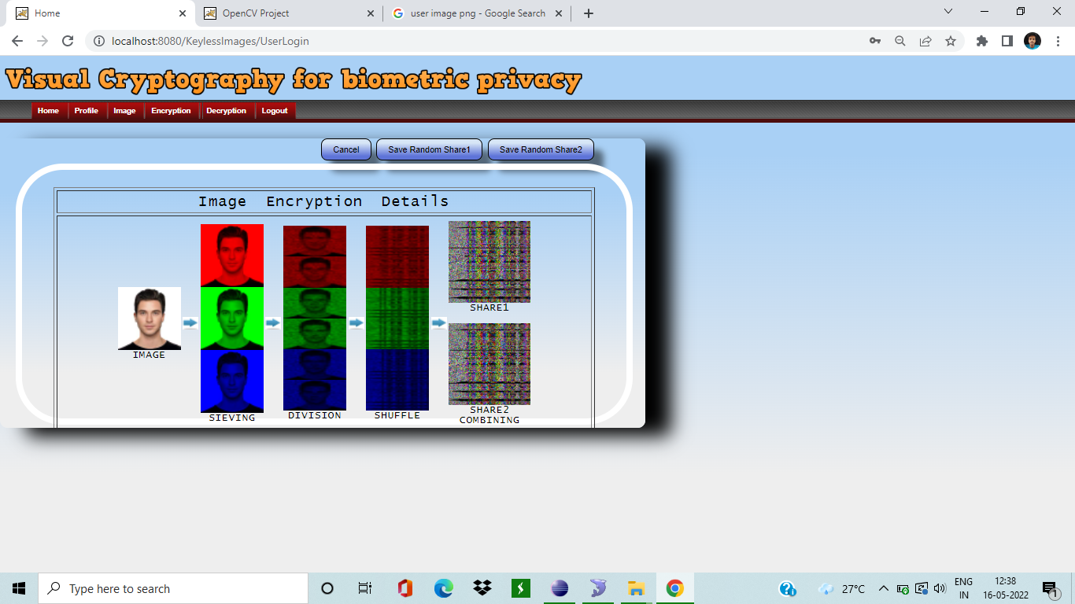
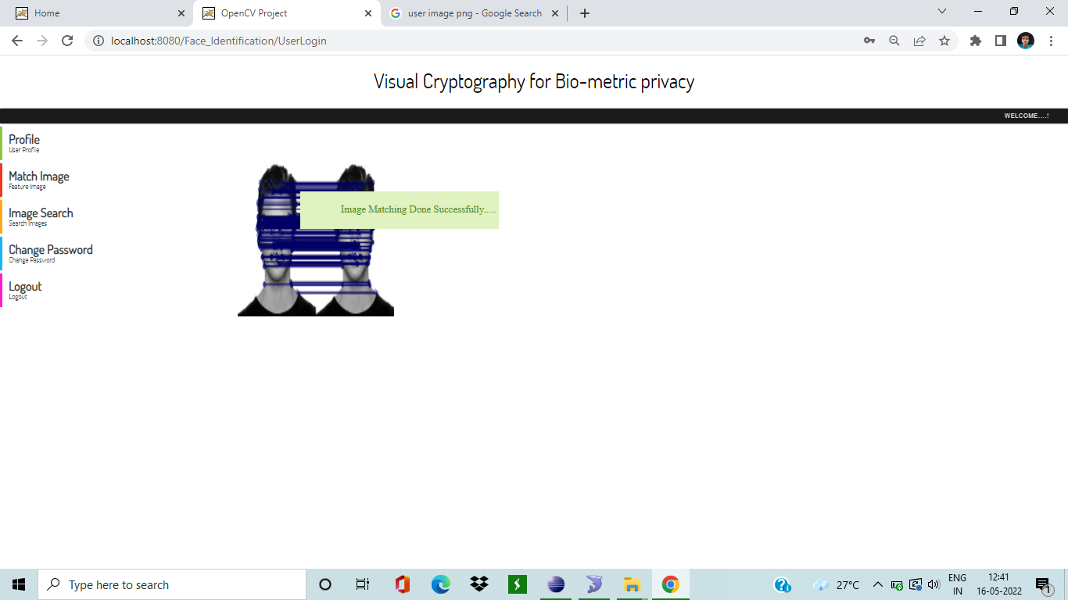
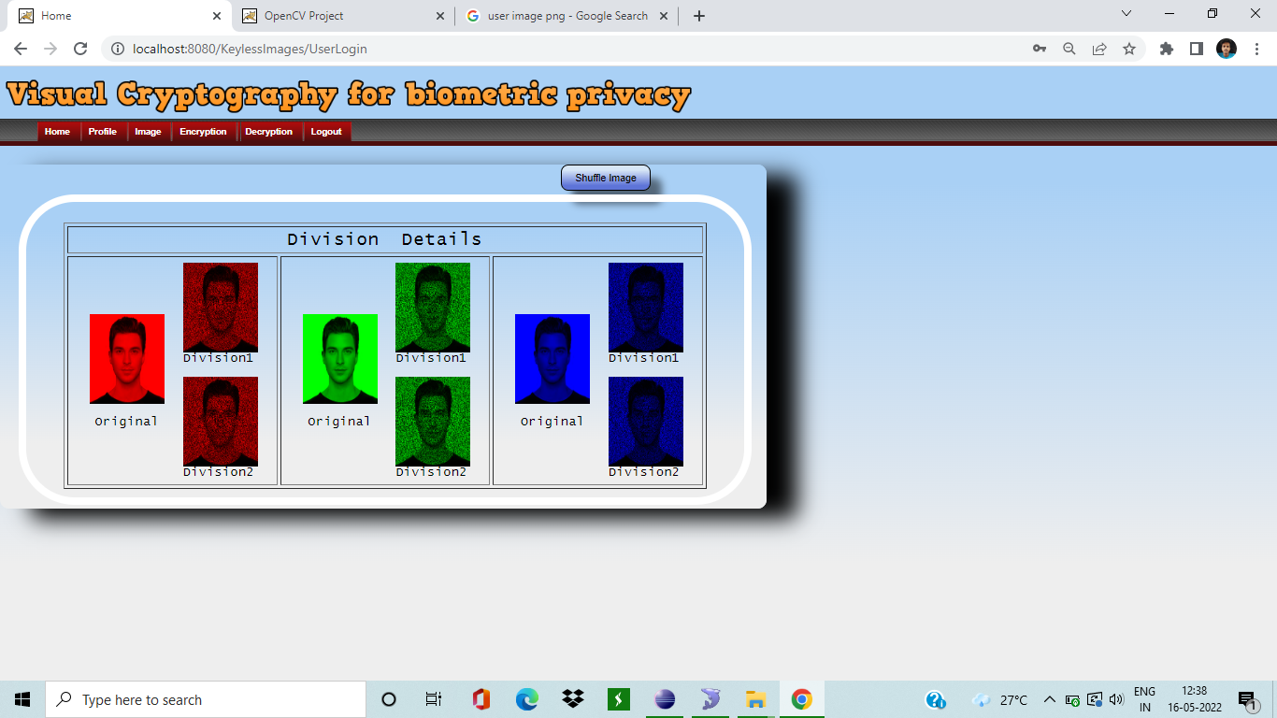
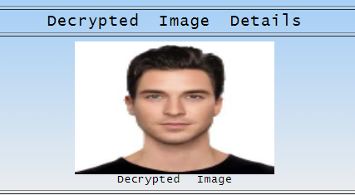
Results & Discussions
Original image
Image Division:
Encryption Process:
Decryption Process
Face Matching

Slide 11
Conclusion
VC is basically an encryption method which has a merit of decrypting encrypted images rather than cryptographic computations.
The significance of VCS in enhancing in the security and integrity of secret information has also been considered. The proposed system is done with Floyd Steinberg and blowfish algorithm.

Slide 12
References
[1] Arun Ross, Asem Othman, “Visual Cryptography for Biometric Privacy”, IEEE Transactions on Information Forensics and Security, VOL.6 No.1, MARCH 2011.
[2] Naor, M. and Shamir. A, “Visual Cryptography” EUROCRYPT 1994. Lecture Notes in Computer Science, Vol. 950. Springer, Berlin, Heidelberg (1999).
[3] Shefali Arora & M.P.S Bhatia, “Challenges and opportunities in biometric security: A survey”, Information Security Journal: A Global Perspective (2021).
[4] Jeng - Shyang Pan, Tao Liu, Hong-Mei Yang, Bin Yan, Shu-Chuan Chu, Tongtong Zhu, “Visual cryptography scheme for secret colour images with colour QR codes”, Elsevier November 2021.
[5] Jyoti Tripathi, Anu Saini, Kishan, Nikhil, Shazad, “Enhanced Visual Cryptography: An Augmented Model for Image Security”, (ICCIDS 2019), Published by Elsevier B.V.
[6] M. Karolin and T. Meyyappan, “Secret Multiple Share Creation with Color Images using Visual Cryptography”, April 4-6, 2019, India, IEEE.
[7] M. Karolin, T. Meyyappan, “Image Encryption and Decryption using RSA Algorithm with Share Creation Techniques”, ISSN: 2249 – 8958, Volume-9 Issue-2, December 2019.
[8] P. Punithavathi & S. Geetha (2017), “Visual cryptography: A brief survey”, Information Security Journal: A Global Perspective, 26:6, 305-317 (Taylor & Francis).
[9] M. Karolin, Dr. T. Meyyappan, “RGB Based Secret Sharing Scheme in Color Visual Cryptography”, Vol. 4, Issue 7, July 2015, DOI: 10.17148/IJARCCE.2015.4734.
[10] Apurva A. Mohod, Prof. Komal B. Bijwe, An Image Database Security Using Multilayer Multi Share Visual Cryptography: A Review, ISSN 2319 -4847, Volume 3, Issue 10, October 2014.
[11] Ms Neha Khatri – Valmik, Prof. V. K Kshirsagar, “Blowfish Algorithm”, ISSN: 2278-8727Volume 16, Issue 2, Ver. X (Mar-Apr. 2014), PP 80-83.
[12] Atul Sureshpant Akotkar, Chaitali Choudhary, “Secure of Face Authentication using Visual Cryptography”, International Journal of Innovative Science and Modern Engineering (IJISME) ISSN: 2319-6386, Volume-2, Issue-5, April 2014.

